Slide 1
Bias & Exclusivity in the Digital Humanities
Emily Lopez, Graham Galloway, Hannah Shlesinger
Digital Humanities 101 丨 Dr. Brooks Jessup 丨 June 2021

Slide 2
Presentation Overview
01
02
03
04
Historical Context of Computing Systems
Grassroots movements
& Current Discourse
Hannah
Emily
Maps, Maps, Maps!
How Bias Impacts GIS
Conclusions
Graham
Graham

Slide 3

“Why Are Digital Humanities So White? Or Thinking the Histories of Race and Computation”
1960’s:
UNIX, an early operating system, developed in Bell Labs
Civil Rights Movement
Dr Tara McPherson
Source: USC Cinematic Arts
Notes:
McPherson draws attention to the social, historical, and political context that computing systems emerged from and while she’s not saying there’s a cause and effect relationship, she is arguing for a greater understanding and recognition of the ways in which the philosophies behind the function of computing systems mirrors racist ideologies that developed from the historical time period that systems like UNIX were developed in
A note on her main argument: Let me be clear. By drawing analogies between shifting racial and political formations and the emerging structures of digital computing in the late 1960s, I am not arguing that the programmers creating UNIX at Bell Labs and in Berkeley were consciously encoding new modes of racism and racial understanding into digital systems.
“We might understand UNIX as the way in which the emerging logics of the lenticular and of the covert racism of color blindness get ported into our computational systems, both in terms of the specific functions of UNIX as an operating system and in the broader philosophy it embraces.”

Slide 4


Lenticular Lens 3D Postcard
Stereoscope
partitions and divides, privileging fragmentation.
Merges two images into an imagined whole
Source: 4Over4
Source: UNC Library
Notes:
the lenticular image A lenticular logic is a logic of the fragment or the chunk, a way of seeing the world as discrete modules or nodes, a mode that suppresses relation and context. As such, the lenticular also manages and controls complexity.”
Drawing from those 3-D postcards that bring two or more images together even while suppressing their connections, I have earlier termed the racial paradigms of the postwar era “lenticular logics.” The ridged coating on 3-D postcards is actually a lenticular lens, a structural device that makes simultaneously viewing the various images contained on one card nearly impossible. The viewer can rotate the card to see any single image, but the lens itself makes seeing the images together very difficult, even as it conjoins them at a structural level (i.e., within the same card). In the post–civil rights United States, the lenticular is a way of organizing the world. It structures representations but also epistemologies. It also serves to secure our understandings of race in very narrow registers, fixating on sameness or difference while forestalling connection and interrelation.

Slide 5
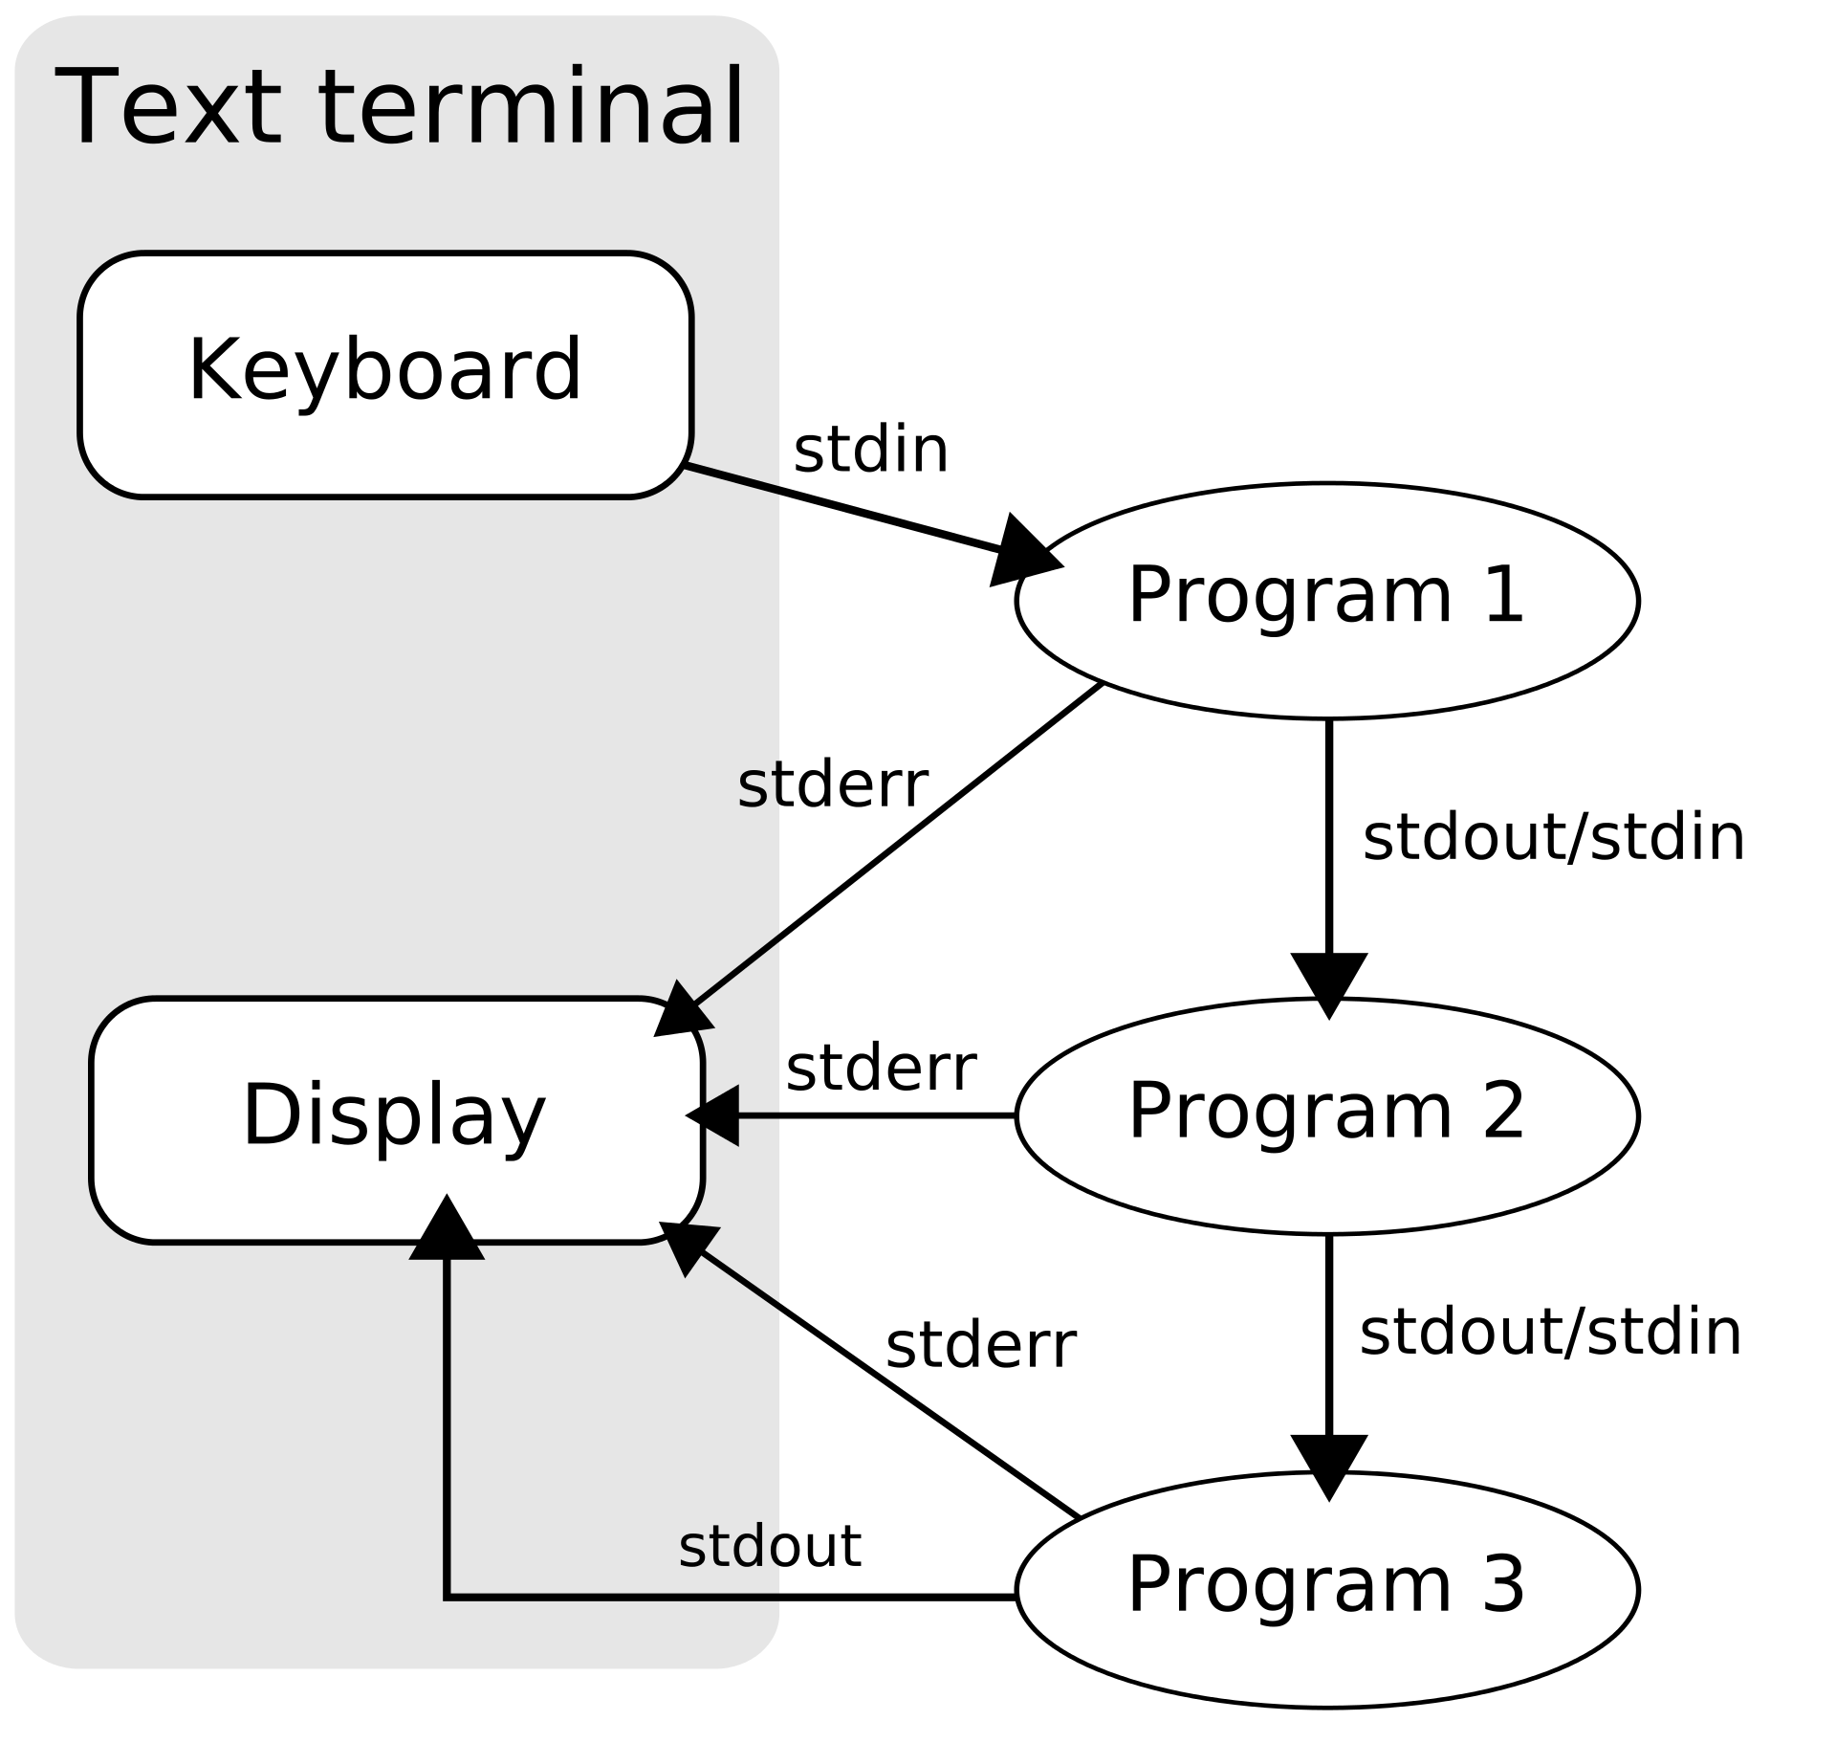
Modular Thinking
In UNIX:
The ‘pipeline’
The kernel is hidden behind the shell
In 1960s & 1970’s politics:
Identity politics
The emergence of covert racism
rhetoric of color blindness
In The University:
New Criticism
Specialization
Source: Wikipedia
Notes:
McPherson draws attention to the social, historical, and political context that computing systems emerged from and while she’s not saying there’s a cause and effect relationship, she is arguing for a greater understanding and recognition of the ways in which the philosophies behind the function of computing systems mirrors racist ideologies that developed from the historical time period that systems like UNIX were developed in
A note on her main argument: Let me be clear. By drawing analogies between shifting racial and political formations and the emerging structures of digital computing in the late 1960s, I am not arguing that the programmers creating UNIX at Bell Labs and in Berkeley were consciously encoding new modes of racism and racial understanding into digital systems.

Slide 6
“So if we are always already complicit with the machine, what are we to do?”
We must historicize and politicize code studies.
Our investigations must incorporate race from the outset
We must understand and theorize the deep imbrications of race and digital technology even when our objects of analysis (say UNIX or search engines) seem not to be about race at all.”
Notes:
McPherson draws attention to the social, historical, and political context that computing systems emerged from and while she’s not saying there’s a cause and effect relationship, she is arguing for a greater understanding and recognition of the ways in which the philosophies behind the function of computing systems mirrors racist ideologies that developed from the historical time period that systems like UNIX were developed in
A note on her main argument: Let me be clear. By drawing analogies between shifting racial and political formations and the emerging structures of digital computing in the late 1960s, I am not arguing that the programmers creating UNIX at Bell Labs and in Berkeley were consciously encoding new modes of racism and racial understanding into digital systems.
Convert to bullet points

Slide 7
Grassroot Movements and Current Discourse on Bias & Exclusivity in the Digital Humanities

Slide 8
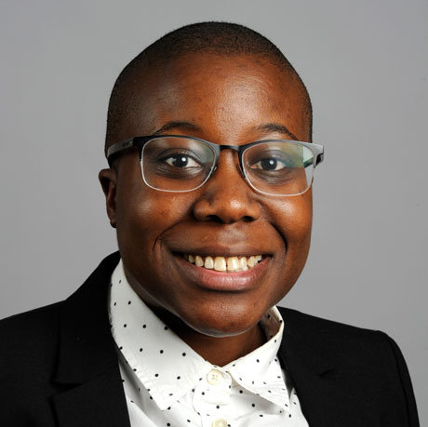
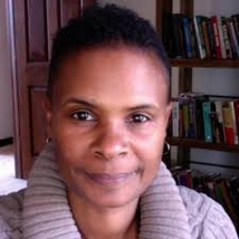
“All the Digital Humanists Are White, All the Nerds Are Men, but Some of Us Are Brave”
“Making a Case for the Black Digital Humanities”
Moya Bailey
Assistant Professor at
Northeastern University
Kim Gallon
Associate Professor at
Purdue University
https://cssh.northeastern.edu/faculty/moya-bailey/
https://cla.purdue.edu/directory/profiles/kim-gallon.html
Notes:
Similar to McPherson’s concluding note, the authors Moya Bailey and Kim Gallon call for a deep, structural reimagining of the humanities/digital humanities

Slide 9
“ The Black digital humanities helps unmask the racialized systems of power at work in how we understand the digital humanities as a field and use its associated techniques.”
Kim Gallon
Notes:
Provides an argument for the Black Digital Humanities (intersection between Black studies and digital humanities)
helps unmask the racialized systems of power at work in how we engage with the digital humanities
digital humanities tools would still be used the same if they had been developed to explore texts that have been marginalized through the racialization of the humanities

Slide 10
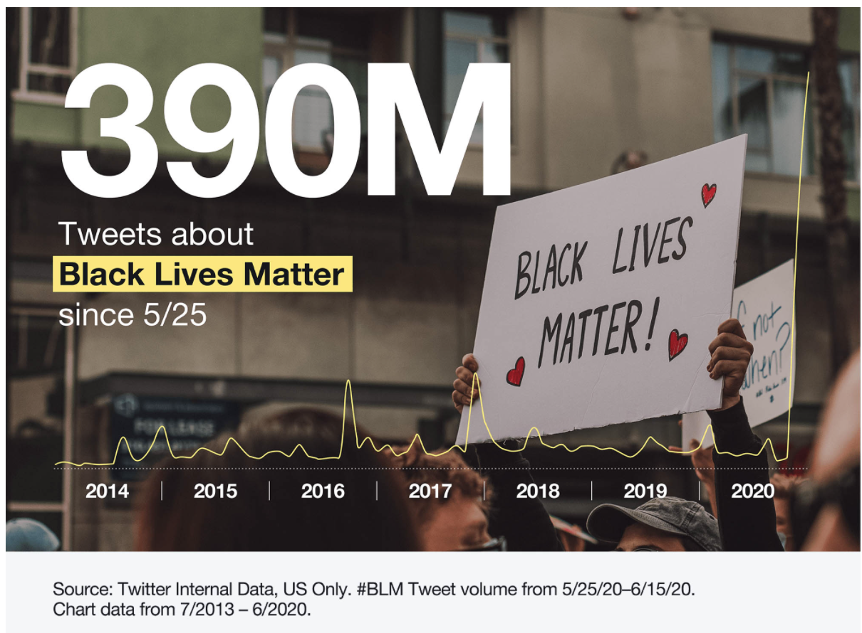
Projects & Technologies of Recovery in the Black Digital Humanities
Recover alternate constructions of humanity that have been historically excluded
It’s also the recovery/restoring of black authors’ and people’s humanity
Operate as the shared basis for black academic and nonacademic digital work.
Notes:
Recovery rests at the heart of black studies so the project of recovery should be foundational to the BDH
SHE EXPLAINS THAT humanities foundation is challenged by
recovering alternate constructions of humanity that have been historically excluded
these efforts at recovery can be understood not only as the recovery of “lost and difficult to locate texts,” but also as the recovery of black authors’ humanity
The technology of recovery also operates as the shared basis for black academic and nonacademic digital work.
Gives examples of technologies of recovery, which are as simple as the interactions on social media, like through influential tweets and hashtags on Twitter which give a voice to these marginalized communities

Slide 11
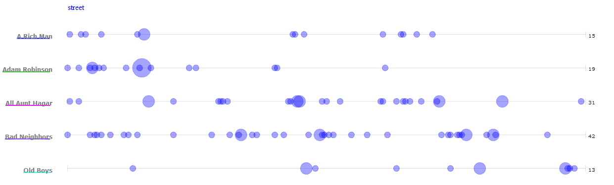
Digital recovery projects that are either led by or heavily invoke black scholars are particularly impactful in how they expand what we understand the digital humanities to be
By Kenton Rambsy https://www.culturalfront.org/2014/01/edward-p-jones-and-literary-geo-tagging.html
Notes:
Digital recovery projects that are either led by or heavily invoke black scholars disrupt the normative, racialized framework of the digital humanities
References Kenton Rambsy an assistant professor at University of Texas at Arlington and his work in geo-tagging or literary geo-tagging.
The example shows the usage of the word “street” across these articles by the author Edward P Jones.
Hopes that critical consideration of the connections between black studies and the digital humanities will help advance work addressed by organizations that are working to redefine the field
-----
“Scholars of African American literature typically focus on geography and migration in fiction, but using text mining allows them to consider to what extent black writers “tag” their stories with actual cities and use landmarks and neighborhoods to construct environments.”

Slide 12
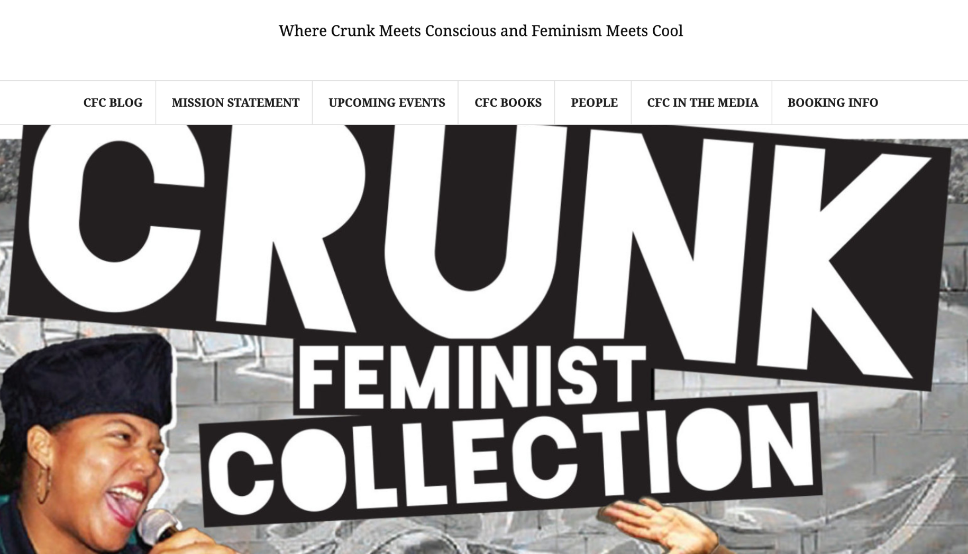
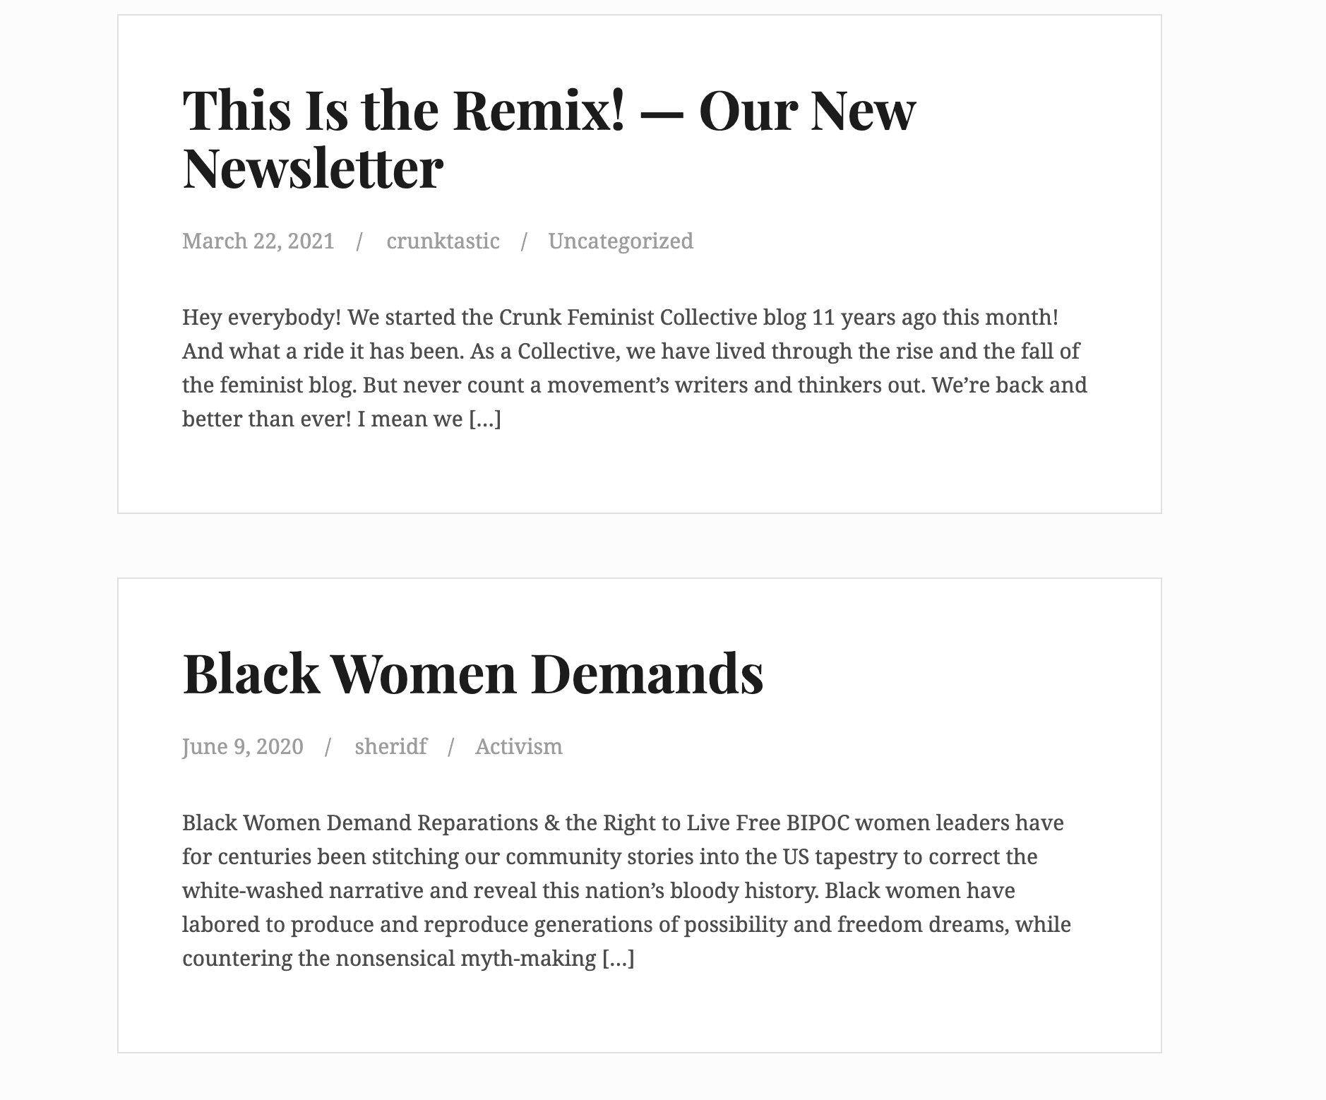
“What counts as a digital humanities project?”
By centering the lives of women, people of color and disabled folks, the developments/conversations in the digital humanities may shift
Increased recognition of intersectional projects in the digital humanities is needed
https://www.crunkfeministcollective.com/
Notes:
There is currently racialized and gendered aspects of the digital humanities, but by centering the lives of women, people of color and disabled folks, the developments and conversations in the digital humanities may shift
“move from margin to center” offers opportunity to engage in new sets of theoretical questions that expose the shortcomings of this field
One of the first things to consider is what counts as the DH? there are projects that aren’t recognized as such but definitely engage in intersectional DH work
The Crunk Feminist Collective:
Collective of academics and activists use social media platforms to talk about the realities of our world in accessible feminist language

Slide 13

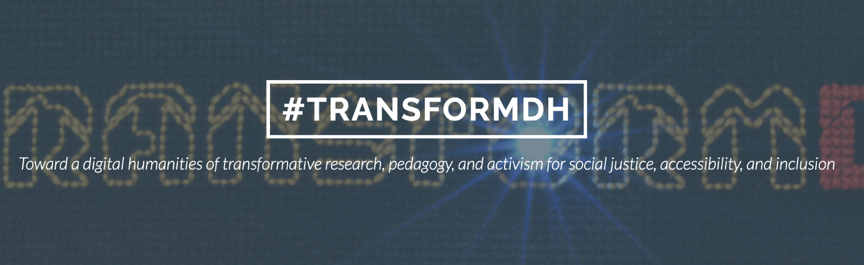
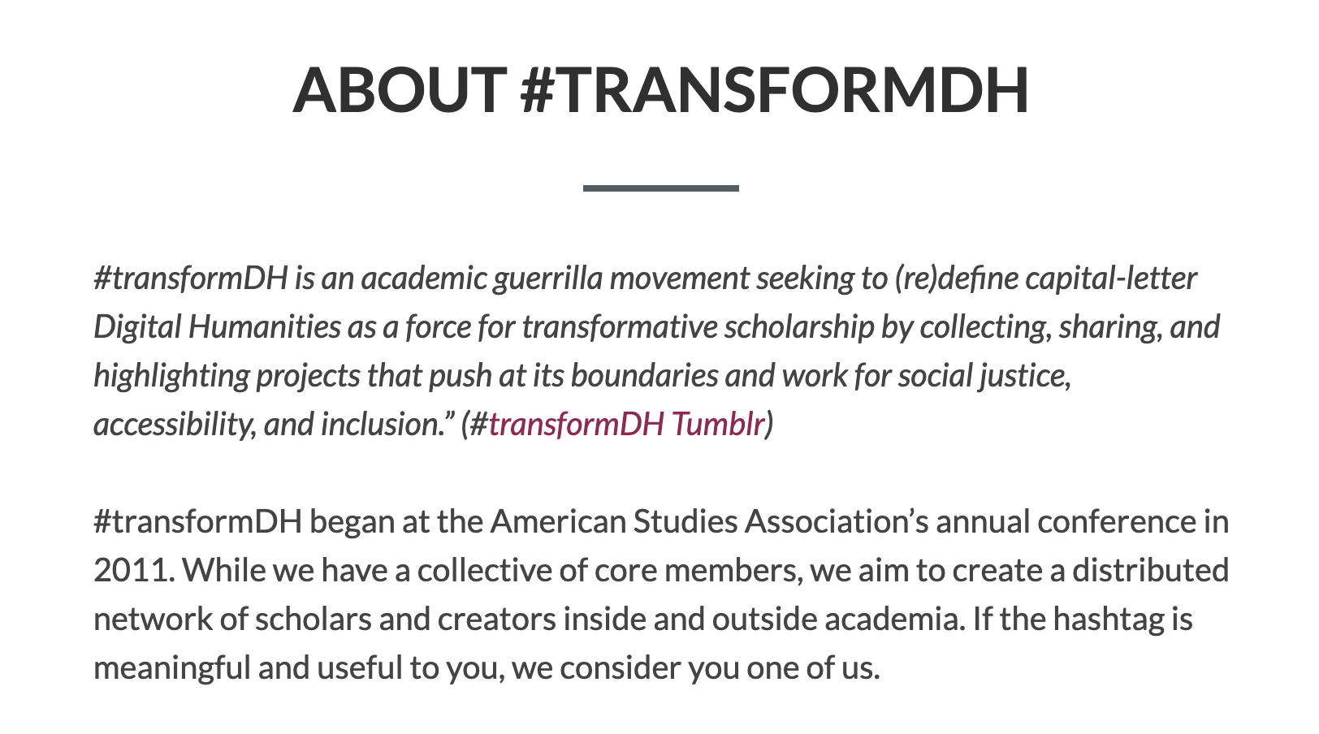
“There is an elasticity to digital humanities that makes this a solvable problem, and people are already working through it.”
Moya Bailey
Image from https://www.blackgirlscode.com/
https://transformdh.org/about-transformdh/
Notes:
The DH has an elastic nature which allows activism from diverse groups
There are organizations that call attention to topics of representation, diversity and inclusivity in the DH and inspire reform in the field
#TransformDH:
BLACK GIRLS CODE
As opposed to the Identity based mixing approach or meeting people of these marginalized communities where they are in the DH, we should: Instead center these voices and focus on work that is pushes the field in new directions
-----
#transformDH is an academic guerrilla movement seeking to (re)define the Digital Humanities as a force for transformative scholarship
Grassroot organization reaching girls of color in elementary and middle schools with opportunities to engage STEM

Slide 14
Maps as a Tool For Social Change
From the reading by Denise Pacheco and Veronica Nelly Velez
Notes:
I’m going to talk a little bit about how we use tools like maps and GIS in the digital humanities and how these mediums create meaning
This section I’m going to give some examples/case studies that illustrate the critical theories that Hannah and Emily were talking about.
So I want to go over maps as a data visualization tool first and talk about subjectivity in maps.
We’re used to seeing maps as objective “gods eye view”, but they’re not!

Slide 15
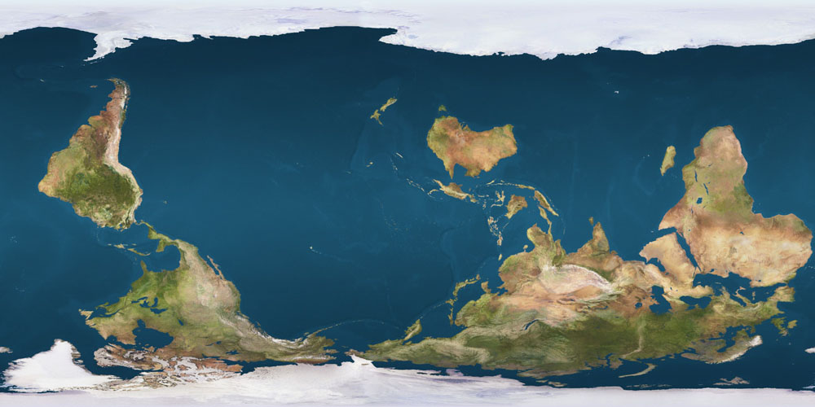
What’s wrong with this map?
Source: Wikimedia Commons
Notes:
Well, there’s nothing really wrong with this map! It just represents a different worldview. We’ve become accustomed to North = Up, but that’s just an arbitrary orientation. There is no “correct” up/down orientation of a world map, because there is no up/down orientation in space. This map is just as accurate as any north up world map you’ve seen before.
In the 20th century, many anti-colonial African and South American activists used the South-Up map as a form of resistance against European colonialism and dominance. Many cultures associated “up” with power, and so this map can be used to assert power.
This map, as with all maps, reflects the worldview of its creator. The mapmaker is making a statement with this map.
While we’re used to seeing maps as completely objective displays of information, the choice of what information is included in maps reflects the subjective worldview of the mapmaker.

Slide 16
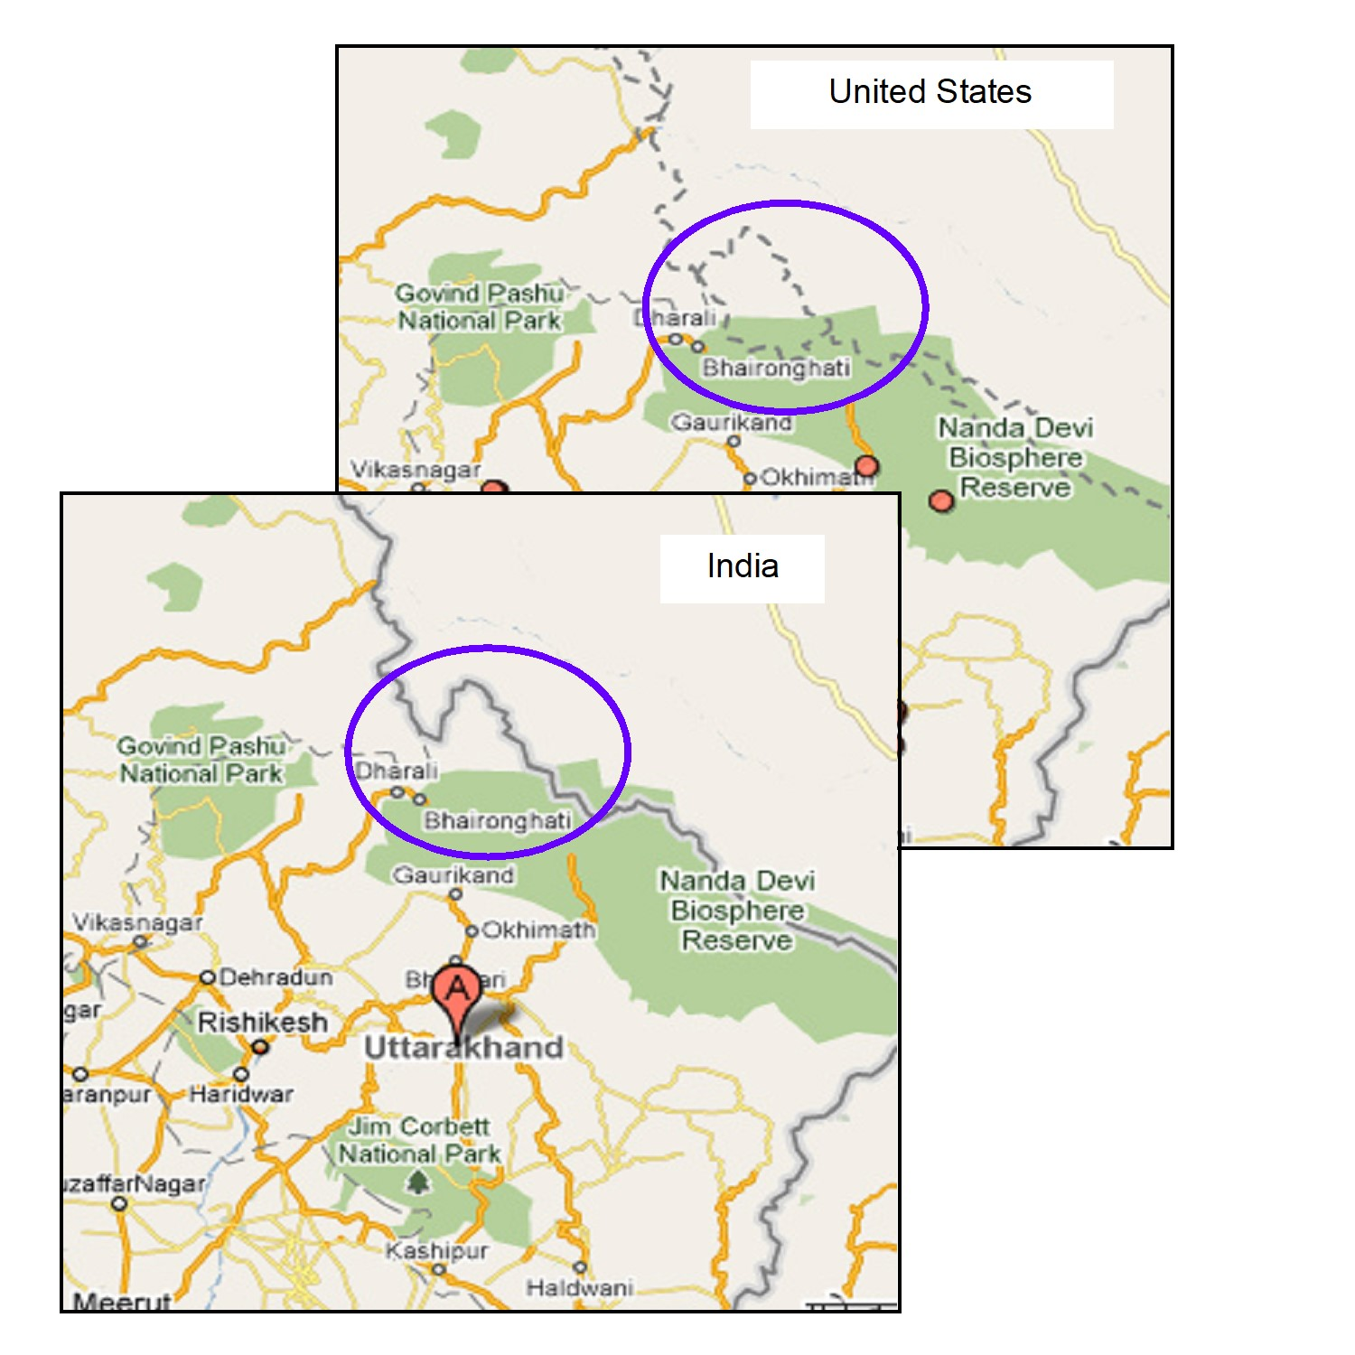
These two maps show the same area, but very
different information
Google maps shows different borders depending on in which country you’re using it
India is using Google maps to assert their claim over the disputed territory of Kashmir
Source: Google Maps
Notes:
India and Pakistan both claim Jammu and Kashmir. The figure below shows how Google Maps images of the region appear differently whether the search is conducted in the US (which considers the two states’ territorial claims on Jammu and Kashmir to be unsettled) or India (which reasserts its claim to Jammu and Kashmir in the map).
Maps are fantastic tools for VALIDATION.

Slide 17
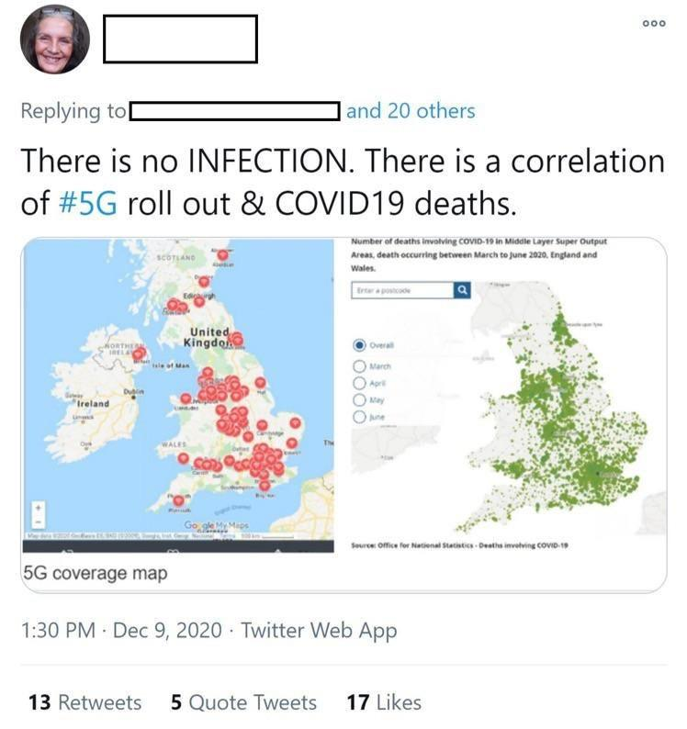
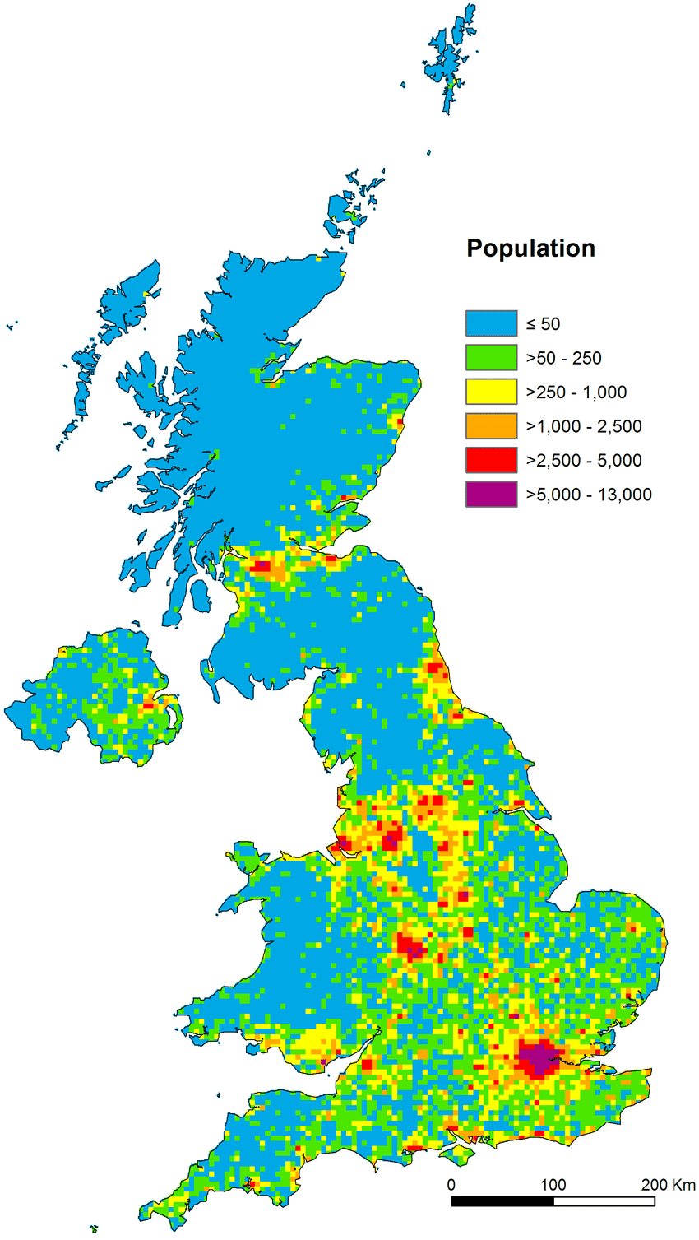
Source: Twitter
Source: researchgate.net
Notes:
Disregarding the “There is no INFECTION” statement, the twitter post is not lying. Her statement is objectively true and the maps are perfectly accurate, yet they are misinforming the viewer.
Someone who sees the maps on the left might make a rash decision because of it.
Interpretation is manipulation

Slide 18
I know what maps are, but what about GIS?
Short answer: A map featuring some kind of data.
Slightly longer: GIS, short for “Geographic Information System”, is a data visualization method that connects descriptive information and data to location.
Just about every map we see uses some form of GIS.
As with every form of data visualization, creation and interpretation of GIS involves conscious choices from the researcher and reflects aspects of their worldview and biases

Slide 19
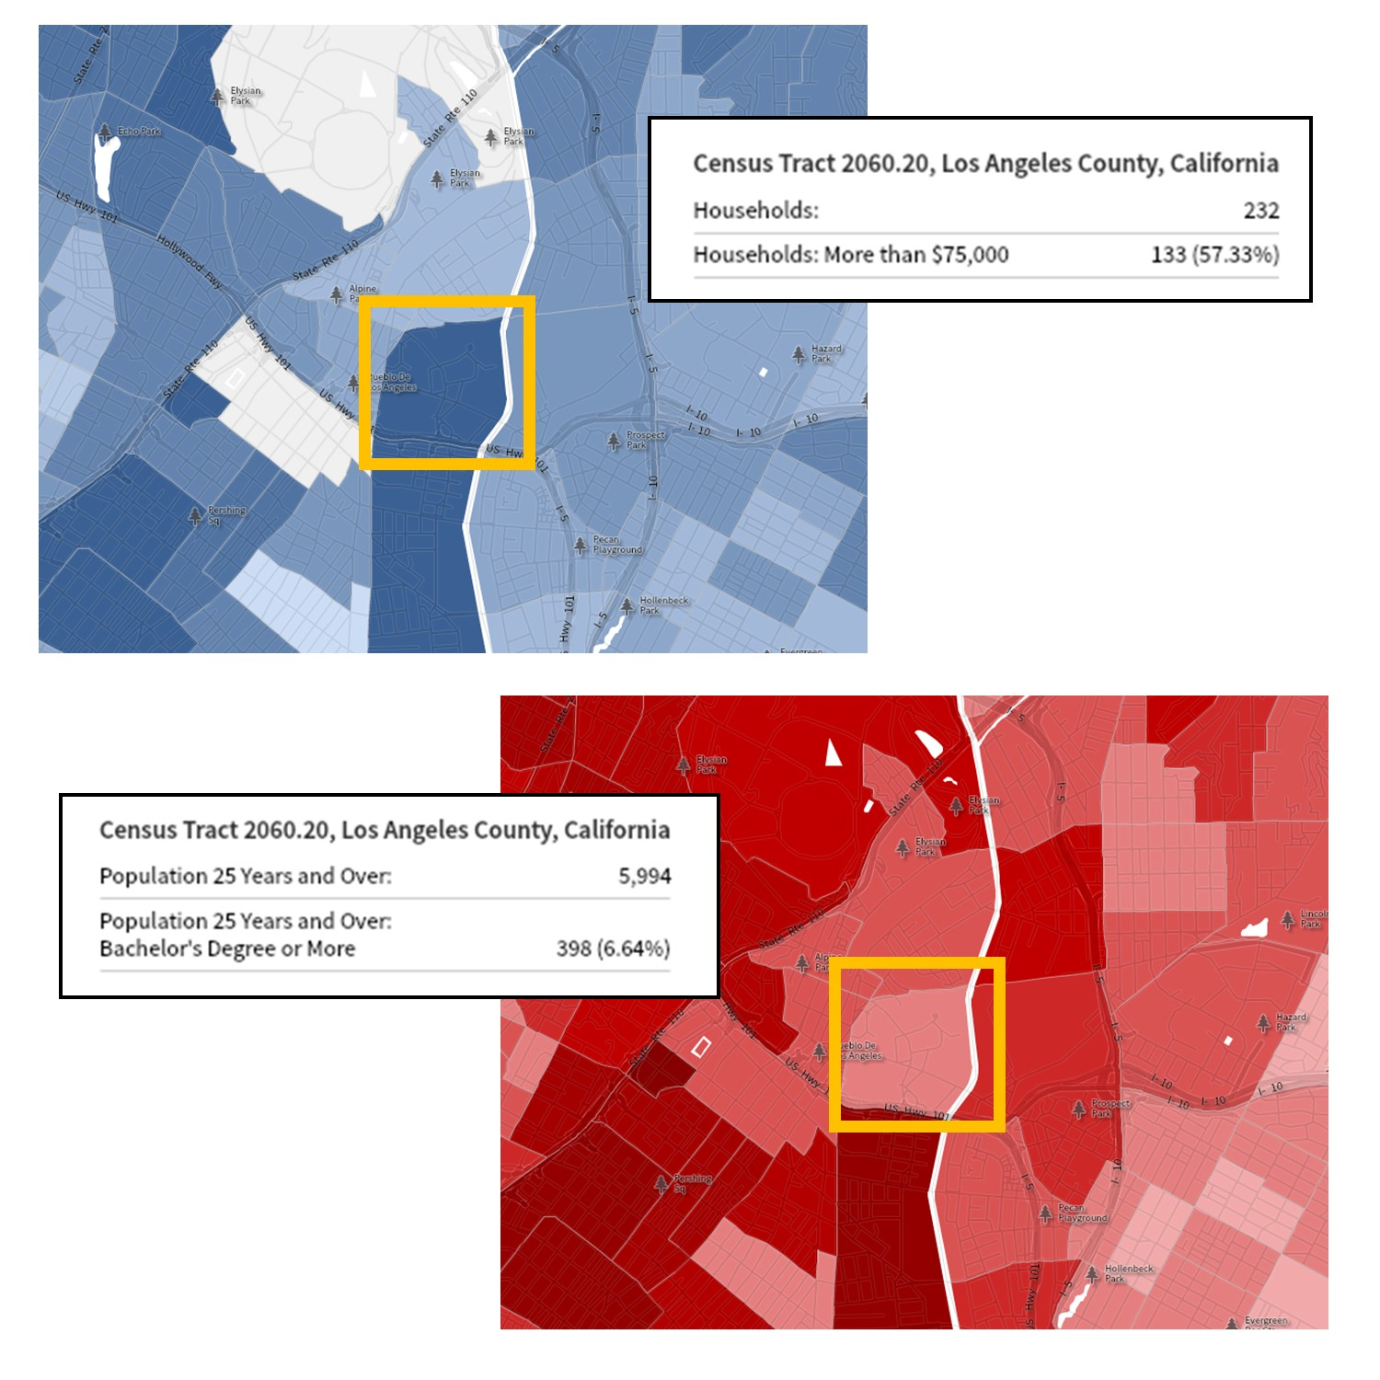
What story does this map tell us?
This map shows census data from the area including Twin Towers Correctional Facility and the Men’s Central Jail in Los Angeles County.
The map above shows percentage of “high income households”
The map below shows education level
Normally, these two categories show high correlation, but why not here?
Source: open.lib.umn.edu
Notes:
The US Census does NOT consider imprisoned people as part of their household income and poverty metrics, but DOES include them when studying education levels.
You can see how this kind of data collection method and mapping might make it very difficult to adequately account for population, ensure reasonable representation, and manage appropriations in prison-based communities, as well as the communities from which incarcerated populations come.

Slide 20
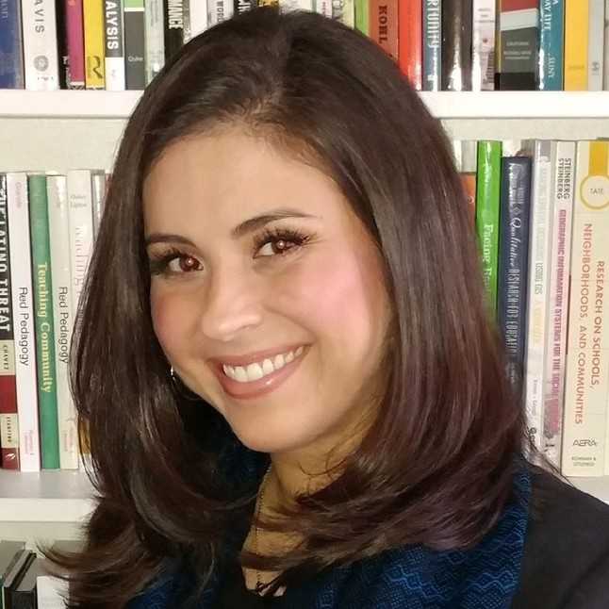
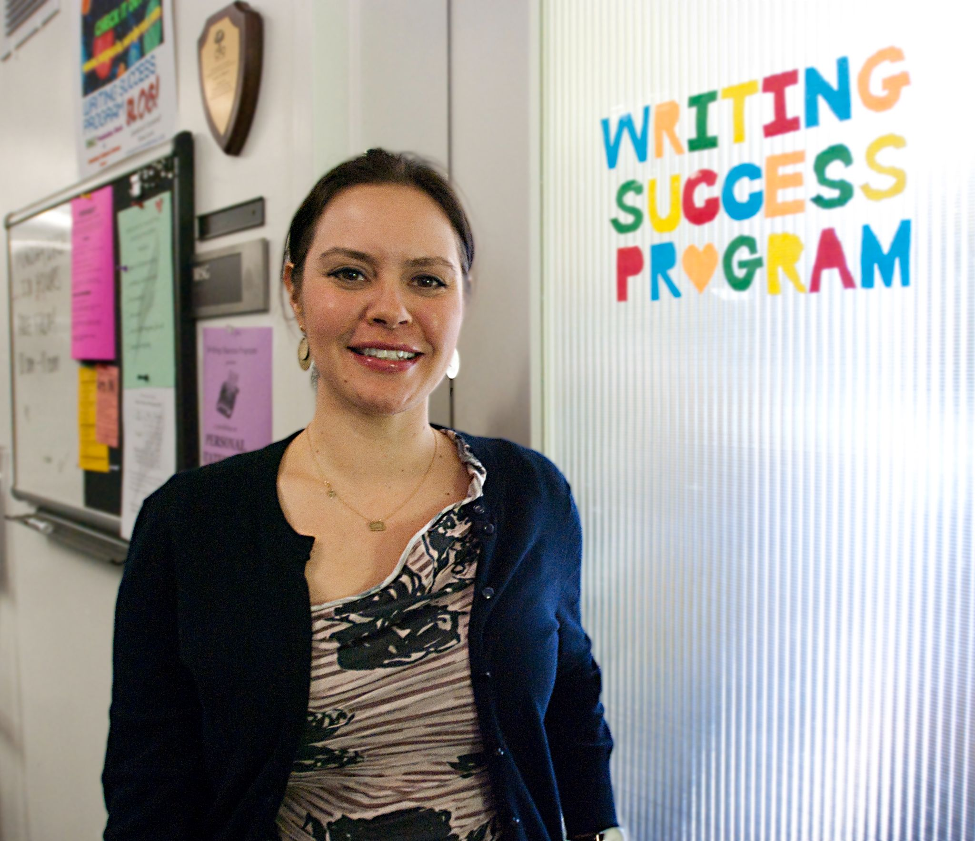
Pacheco and Velez
In “Maps, Mapmaking, and Critical Pedagogy: Exploring GIS and Maps as a Teaching Tool for Social Change,” UCLA researchers Denise Pacheco and Veronica Nelly Velez talk about how GIS is involved in education
How would public school district maps be different if students, teachers, and parents contributed to them?
Veronica Nelly Velez
Source: CalGIS 2018
Denise Pacheco
Source: Daily Bruin
Notes:
Pacheco and Velez talk about how school district maps are hugely influential in students’ lives. They dictate which school a kid can go to based on their neighborhood, as well as how much funding goes to certain public schools based on local income tax. Some schools, particularly those in lower income neighborhoods, are left with much lower budgets. Students don’t have access to the same resources. Students, parents, and teachers have very little say in how these maps are made, despite how important they are in their lives.

Slide 21
GIS and maps are used as tools for change
Maps and GIS influence public opinion and policy decisions
Mapmaking and GIS technology gives the mapmaker power to present their narrative in a clear, concise, and professional looking manner
By teaching children from underprivileged and underrepresented backgrounds how to use GIS technology at an early age, you can empower them
They can tell their own stories through GIS, rather than having someone else use GIS to tell a story about them
Notes:
Can GIS be used to display qualitative information?
GIS is most commonly associated with mapping quantitative data
Pacheco and Velez propose how it could be used to tell deeper, qualitative stories
For example, neighborhoods can be associated with household income to represent value, but how could you map qualitative value?
If a school is represented on a map as a red dot that represents its lower standardized testing scores, does that accurately reflect the value of its staff and students?
Maps and GIS influence public opinion and policy decisions
Mapmaking and GIS technology gives the mapmaker power to present their narrative in a clear, concise, and professional looking manner
By teaching children from underprivileged and underrepresented backgrounds how to use GIS technology at an early age, you can empower them
They can tell their own stories through GIS, rather than having someone else use GIS to tell a story about them

Slide 22
There’s no such thing as a neutral tool or researcher
Notes:
Digital humanities poll

Slide 23
THANKS!
The screen is a mirror of the soul

Slide 24


